Slide 1
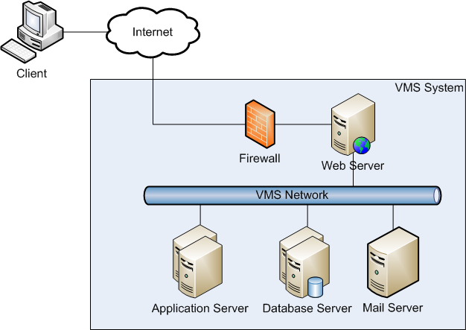
Overview System Architecture

Slide 2
System Architecture
Web Server
Apache 2.2
Apache Load Balancer (JK module)
Application Server
Tomcat 6.0
Database Server (RDBMS)
Microsoft SQL Server 2008
Mail Server
POP Mail server (eg. Gmail)

Slide 3
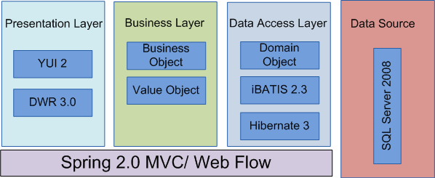
High Level Architecture – Framework Overview

Slide 4
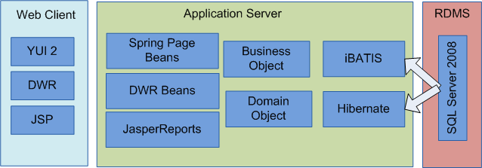
High Level Architecture – Framework Overview

